Slide 1

Basic Details of the Team and Problem Statement
Ministry/Organization Name/Student Innovation:-Ministry of Law and Justice
PS Code: SIH1285
Problem Statement Title: AI-powered Legal Documentation Assistant
Team Name: LegalEase.
Team Leader Name: Mani Chourasiya
Institute Code (AISHE): C-36003
Institute Name: Prestige Institute Of Engineering Management and Research Indore
Theme Name : Miscellaneous.
9/23/2023

Slide 2
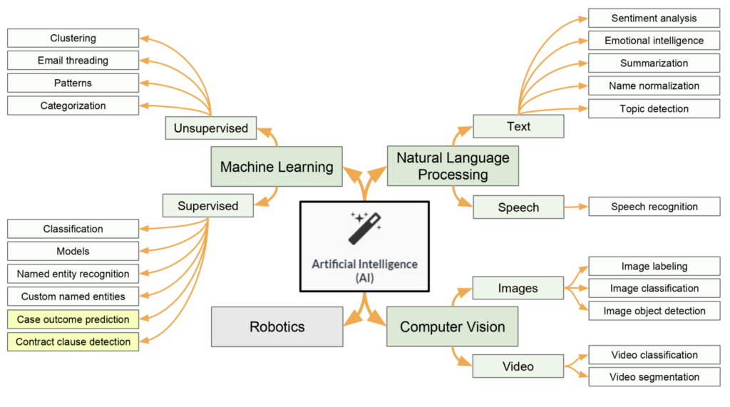







Idea /Approach Details
idea/Solution/Prototype:
1. Goal:
Develop an innovative system.
Purpose: Detection and Generation of document.
2. Methodology:
Utilizes image processing and machine learning algorithms and Optical Character Recognition.
3. Technologies Used:
Employs OCR, Cloud Computing, Python and deep learning techniques.
4. Functionality:
Analyzes and specify document based on their originality and visual attributes.
5. User Base:
Target users: lawyers, Paralegals ,small business and non - lawyers.
User Interaction: Capture images of documents using a smartphone or camera a.
6. System Output:
Provides swift and accurate identifications.
Offers relevant legal authorities and usage information.
7. Significance:
Advances in technology.
Impact: Expertise the identification process.
Promotes responsible use of OCR .
Maximize security and encryption of the documents.
Technology stack:

Slide 3
Idea/Approach Details
Use Cases
Dependencies / Show stopper
Awareness about fraud related to Document Fraud.
Resolving Document verification and generation.:
Generate in easy, jargon free language and error less document which is easily empathize with small business.
Supporting the judiciary process of Indian constitution and law Can be used for a wide range of users including lawyers , paralegals and non lawyers.
Accuracy and reliability during Document generation .
Lack of legal expertise , also ethical and legal concern
Lists additional information regarding the
Document Detection.
Because of Easily access to everyone Data security and encryption issue arises.

Slide 4
Team Member Details
Team Leader Name: Mani Chourasiya
Branch (BTech) Stream (AIDS) Year (III)
Team Member 1 Name: Simran Pawar
Branch (BTech) Stream (AIDS) Year (III)
Team Member 2 Name: Deepak Singh
Branch (BTech) Stream (AIDS) Year (III)
Team Member 3 Name: Aman Sharma
Branch (BTech) Stream (AIDS) Year (III)
Team Member 4 Name :Chetan Khepadia
Branch (BTech) Stream (AIDS) Year (III)
Team Member 5 Name: Tarun Kohli
Branch (BTech) Stream (AIDS) Year(II)
Team Mentor 1 Name: Prof . Diksha Bharawa Expertise : Data science Statistics Domain Experience (in years): 3 yrs.
Category: Academics

